Slide 1
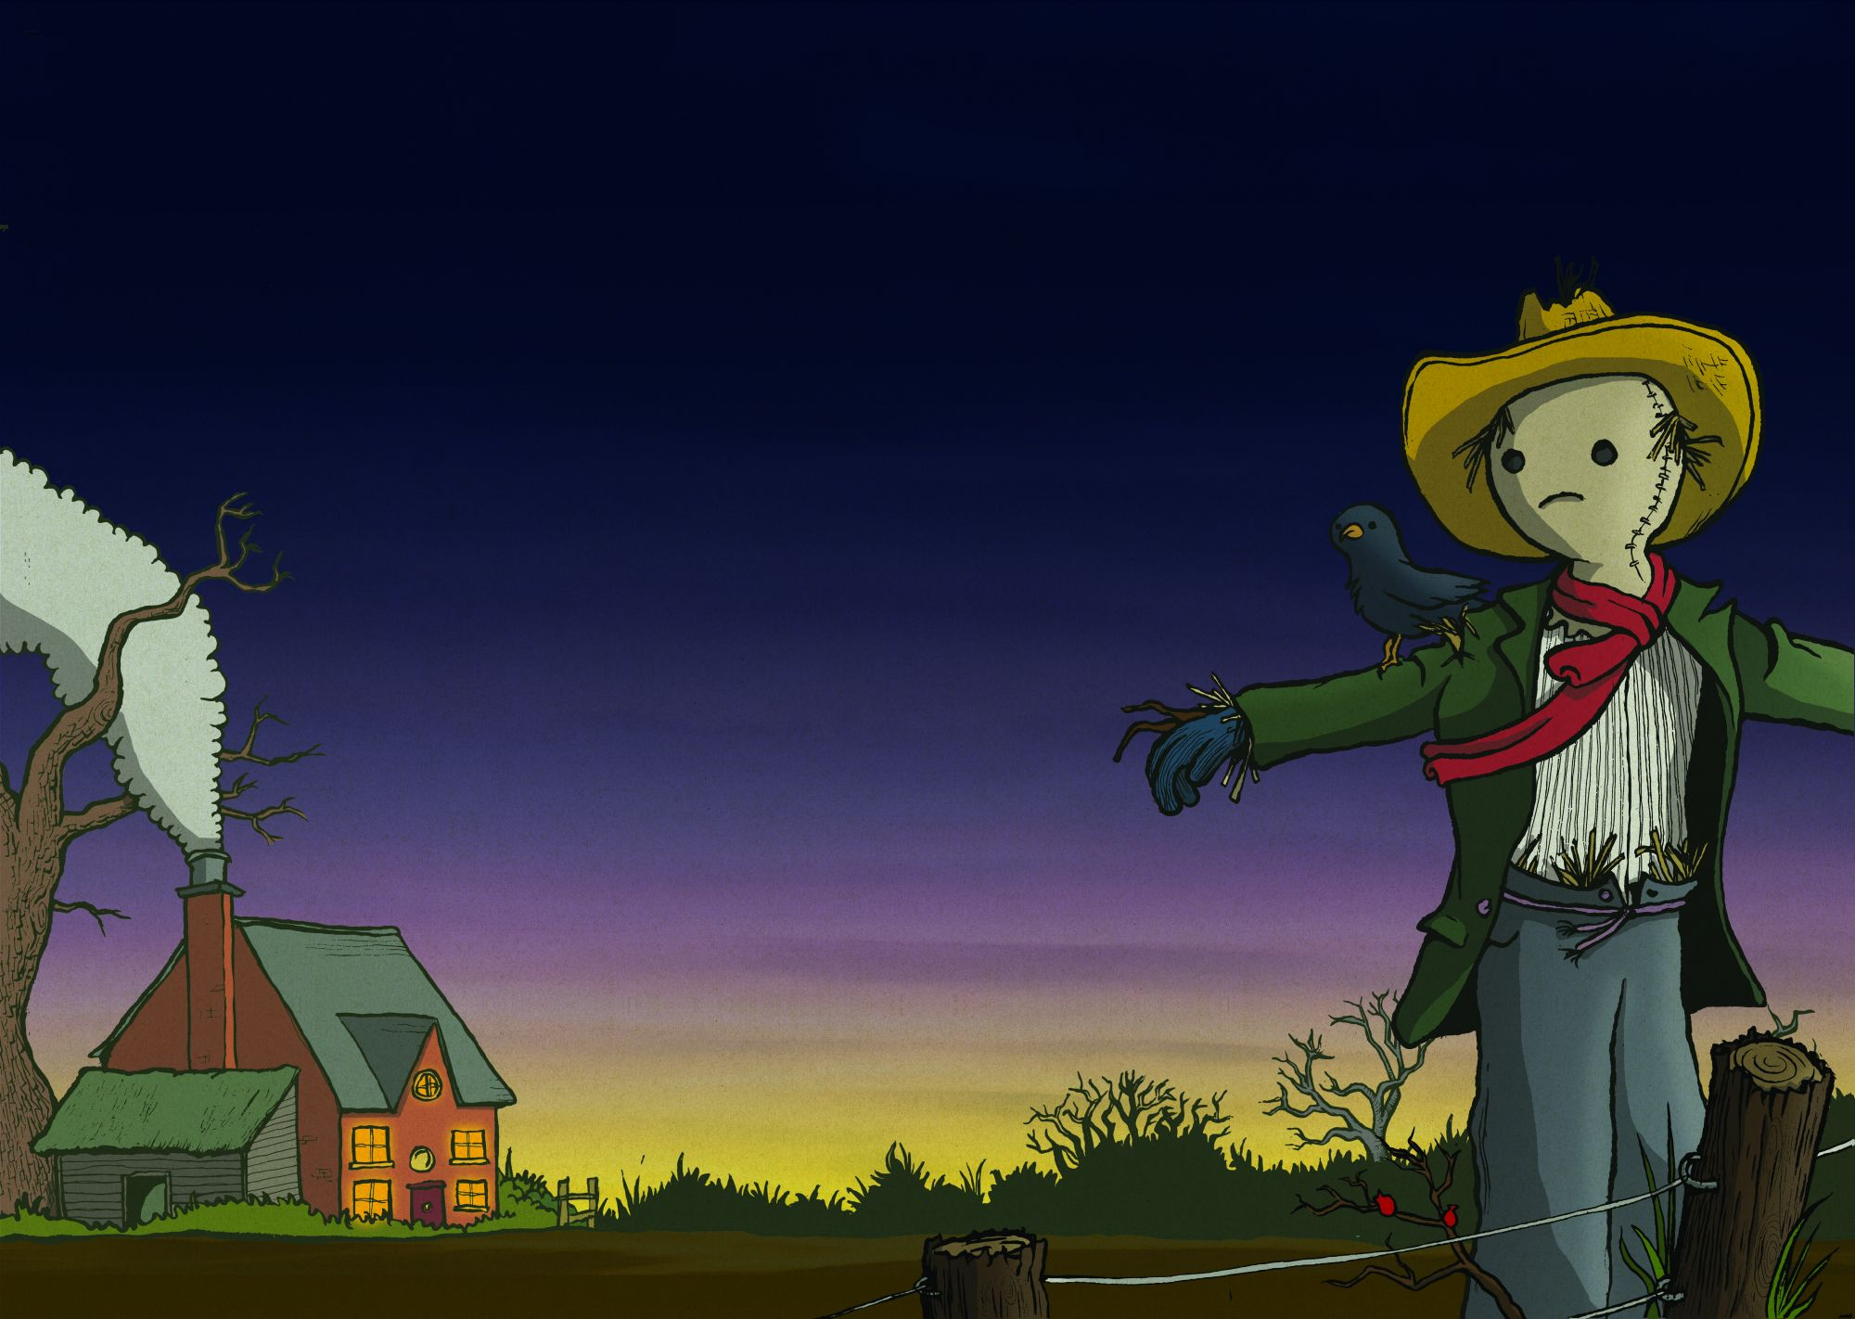
Scarecrow Christmas
In Winter fields
a scarecrow sings
the hopeful tunes
of lonely kings.
His empty heart
is thin and cold;
his cruel rags
are worn and old.
In bed at night
we listen for
padded footsteps
at the door.
In our homes
we sing out clear
warm words of joy
and know no fear.
In other fields
and different lands
living scarecrows
reach out hands.
They live beneath
the sun’s cruel rays.
They do not know
of Christmas days.
Notes:
1
1

Slide 2
Christmas Haiku
Dawn - Christmas arrives;
Gran snoozes on the sofa
Sun peeks through dark clouds.
Church bells ring out clear;
Presents bulge with surprises.
Crackers detonate.
Carols in King Street;
crisp frost glitters underfoot –
a pavement of stars
Silver tinsel glints –
Candles glow in the darkness.
The TV mumbles.
A lone star glistens
above the bleak city streets;
Foxes raid dustbins.
Notes:
2
2

